Slide 1

West Coast Hospital Care
Group 3: Sydney & Mirtha

Slide 2
As if we were approached by a client with special medical needs, who requires frequent access to a local hospital offering specialized, quality care -
Our goal for this project:
Create a tool for our client to use in order to determine the best place for them to seek medical care.
Focus on the West Coast (WA, OR, and CA) because that’s where our client wants to live.
Look at several different factors a patient may consider when deciding on their local hospital
Visualize these findings in a user-friendly way

Slide 3
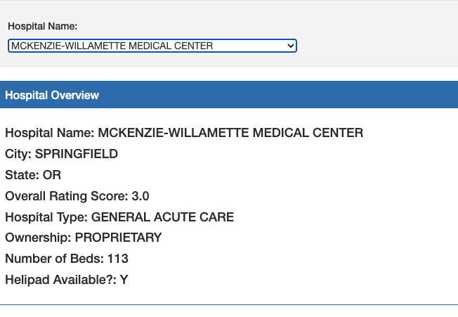
Dataset Source: “Hospitals in the United States” (Kaggle)
Two CSV files:
Hospital General Information
Hospital Location Information
This dataset was originally published by Centers for Medicare and Medicaid Services. Last update was 9 months ago.
How we filtered it:
Reduced columns to the information we were most interested in for analysis
Focused on hospital locations on the West Coast for our client’s interest
Resulted in 248 hospital locations we could compare

Slide 4

Visualizations
Created 3 different visualizations to reflect out data
Map with all hospitals located in the west coast
Bar chart with the rating of the hospitals in the west coast
Pie chart with the different hospital ownerships
User-driven interaction
A drop down that will provide you with more characteristics of the hospital chosen

Slide 5
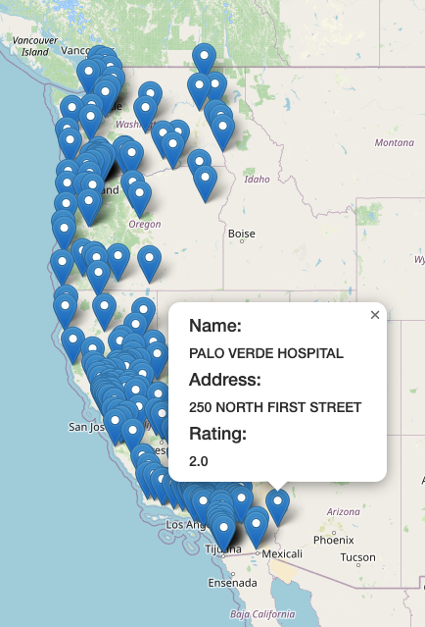
Mapping Hospital
Locations
Showcases markers for each of the 248 hospitals in our dataset
Provides the hospital name, address, and rating score

Slide 6
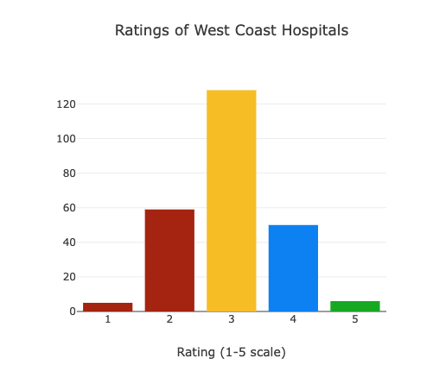
Bar Chart Showing Overall Rating Trends
Capturing the ratings of each hospital and overall trends seemed important for a potential patient
We saw a normal bell curve, with only six 5.0 rated hospitals out of the 248 locations.
Ratings were between 1 and 5, not continuous

Slide 7
Top 6 Hospitals with the highest rating were listed:
Hospital | City, State | Overall Rating | Type of Hospital | Ownership
Fresno Surgical Hospital | FRESNO, CA | 5.0 | GENERAL ACUTE CARE | PROPRIETARY
Scripps Green Hospital | LA JOLLA, CA | 5.0 | GENERAL ACUTE CARE | NON-PROFIT
Goleta Valley Cottage Hospital | SANTA BARBARA, CA | 5.0 | GENERAL ACUTE CARE | NON-PROFIT
Santa Barbara Cottage Hospital | SANTA BARBARA, CA | 5.0 | GENERAL ACUTE CARE | NON-PROFIT
Community Hospital of the Monterey Peninsula | MONTEREY, CA | 5.0 | GENERAL ACUTE CARE | NON-PROFIT
Hoag Orthopedic Institute | IRVINE, CA | 5.0 | GENERAL ACUTE CARE | NON-PROFIT

Slide 8
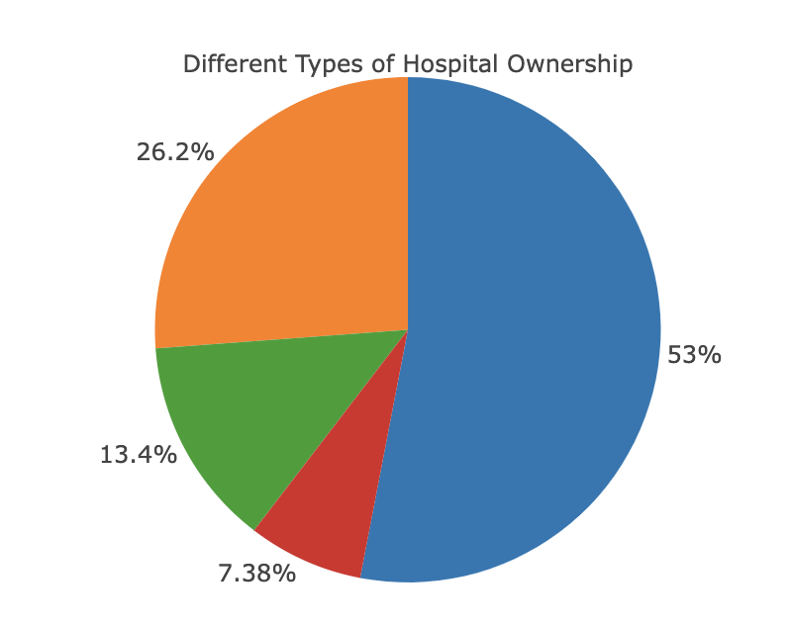
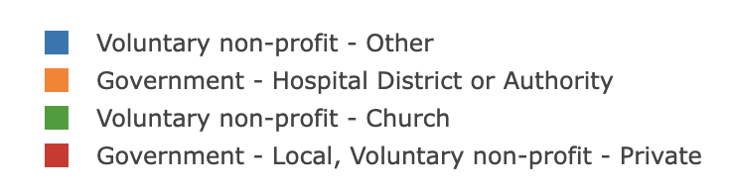
Pie Chart Showing Different Types of Hospital Ownership
There are 4 different types of ownership
Voluntary non profit - Other
Voluntary non profit - Church
Government - Hospital District or Authority
Government - Local, voluntary non profit (private)
Findings showed that more than 50% of hospitals are voluntary non profit.
Around 79 hospitals in the West Coast fall into this category

Slide 9
Limitations/Struggles
Limited by what the dataset considered as a “hospital”. May not include urgent care or emergency room services.
Limited by what Medicaid was looking for, for this data set.
Data set was updated 9 months ago so this data set does not reflect recent changes.
With more time, we could have elaborated the items on our website and made it possible to filter the search criteria.

